Slide 1
计算机组成原理
---双语教学课件
计算机与通信学院
任学惠

Slide 2
William Stallings
Computer Organizationand Architecture
6th Edition
发展
Chapter 2
Computer Evolution and Performance
性能

Slide 3
In this chapter, we shall introduce some peoples and events who or which have put forward for computer’s development.

Slide 4
ENIAC - background
Electronic Numerical Integrator And Computer
Eckert and Mauchly
University of Pennsylvania
Trajectory tables for weapons
Started 1943
Finished 1946
  Too late for war effort
Used until 1955

Slide 5
ENIAC - details
Decimal (not binary)
20 accumulators of 10 digits
Programmed manually by switches
18,000 vacuum tubes
30 tons
15,000 square feet
140 kW power consumption
5,000 additions per second

Slide 6
von Neumann/Turing
Stored Program concept
Main memory storing programs and data
ALU operating on binary data
Control unit interpreting instructions from memory and executing
Input and output equipment operated by control unit
Princeton Institute for Advanced Studies
  IAS
Completed 1952

Slide 7

Structure of von Neumann machine

Slide 8
IAS - details
1000 x 40 bit words
  Binary number
  2 x 20 bit instructions
Set of registers (storage in CPU)
  Memory Buffer Register
  Memory Address Register
  Instruction Register
  Instruction Buffer Register
  Program Counter
  Accumulator
  Multiplier Quotient
存储器缓冲寄存器
存储器地址寄存器
指令寄存器
指令缓冲寄存器
程序计数器
累加器
乘商寄存器

Slide 9

Structure of IAS – detail (Page 20)

Slide 10
Commercial Computers
商业化
1947 - Eckert-Mauchly Computer Corporation
UNIVAC I (Universal Automatic Computer)
US Bureau of Census 1950 calculations
Became part of Sperry-Rand Corporation
Late 1950s - UNIVAC II
  Faster
  More memory
人口普查

Slide 11
IBM
Punched-card processing equipment
1953 - the 701
  IBM’s first stored program computer
  Scientific calculations
1955 - the 702
  Business applications
Lead to 700/7000 series
系列化

Slide 12
Transistors
Replaced vacuum tubes
Smaller
Cheaper
Less heat dissipation
Solid State device
Made from Silicon (Sand)
Invented 1947 at Bell Labs
William Shockley et al.

Slide 13
Transistor Based Computers
Second generation machines
NCR & RCA produced small transistor machines
IBM 7000
DEC - 1957
  Produced PDP-1

Slide 14
Microelectronics
Literally - “small electronics”
A computer is made up of gates, memory cells and interconnections
These can be manufactured on a semiconductor
e.g. silicon wafer
“门”
存储元

Slide 15
Generations of Computer
Vacuum tube - 1946-1957
Transistor - 1958-1964
Small scale integration - 1965 on
  Up to 100 devices on a chip
Medium scale integration - to 1971
  100-3,000 devices on a chip
Large scale integration - 1971-1977
  3,000 - 100,000 devices on a chip
Very large scale integration - 1978 to date
  100,000 - 100,000,000 devices on a chip
Ultra large scale integration
  Over 100,000,000 devices on a chip

Slide 16
Moore’s Law
Increased density of components on chip
Gordon Moore - cofounder of Intel
Number of transistors on a chip will double every year
Since 1970’s development has slowed a little
  Number of transistors doubles every 18 months
Cost of a chip has remained almost unchanged
Higher packing density means shorter electrical paths, giving higher performance
Smaller size gives increased flexibility
Reduced power and cooling requirements
Fewer interconnections increases reliability

Slide 17
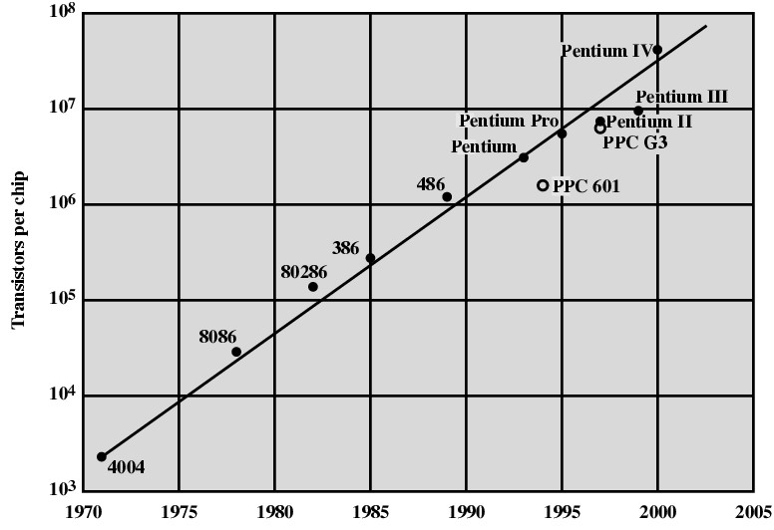
Growth in CPU Transistor Count (page 30)

Slide 18
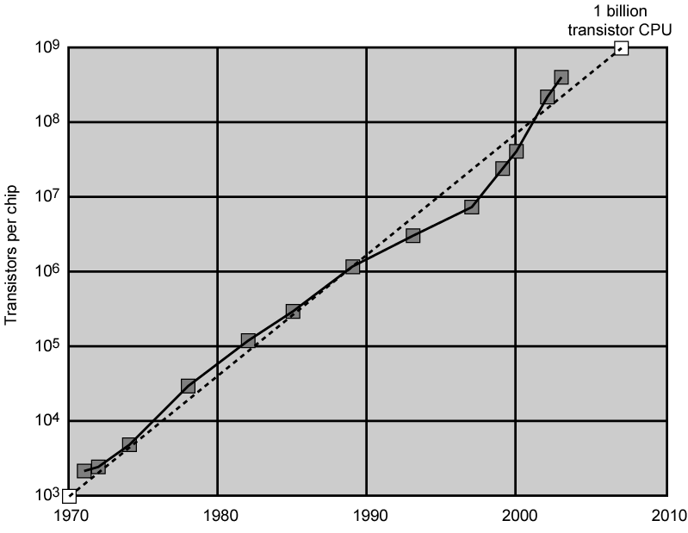
Growth in CPU Transistor Count

Slide 19
IBM 360 series
系列
1964
Replaced (& not compatible with) 7000 series
First planned “family” of computers
  Similar or identical instruction sets
  Similar or identical O/S
  Increasing speed
  Increasing number of I/O ports (i.e. more terminals)
  Increased memory size
  Increased cost
Multiplexed switch structure

Slide 20
DEC PDP-8
1964
First minicomputer (after miniskirt!)
Did not need air conditioned room
Small enough to sit on a lab bench
$16,000
  $100k+ for IBM 360
Embedded applications & OEM
BUS STRUCTURE
总线结构

Slide 21
DEC - PDP-8 Bus Structure
Console
Controller
Main Memory
I/O
Module
I/O
Module
CPU
OMNIBUS

Slide 22
Semiconductor Memory
1970
Fairchild
Size of a single core
  i.e. 1 bit of magnetic core storage
Holds 256 bits
Non-destructive read
Much faster than core
Capacity approximately doubles each year

Slide 23
Intel
1971 - 4004
  First microprocessor
  All CPU components on a single chip
  4 bit
Followed in 1972 by 8008
  8 bit
  Both designed for specific applications
1974 - 8080
  Intel’s first general purpose microprocessor
通用微处理器

Slide 24
Speeding it up
使之更快
Pipelining
On board cache
On board L1 & L2 cache
Branch prediction
Data flow analysis
Speculative execution
流水线
板上CACHE
板上一级、二级CACHE
(指令)转移预测
数据流分析
推测执行

Slide 25
2.2 Performance Mismatch ( page 39)
性能不匹配
Processor speed increased
Memory capacity increased
Memory speed lags behind processor speed
存储器速度滞后于处理器速速度

Slide 26
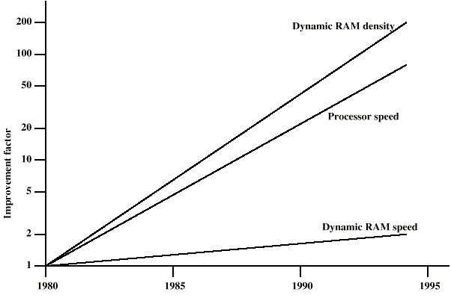
DRAM and Processor Characteristics (page 39)

Slide 27
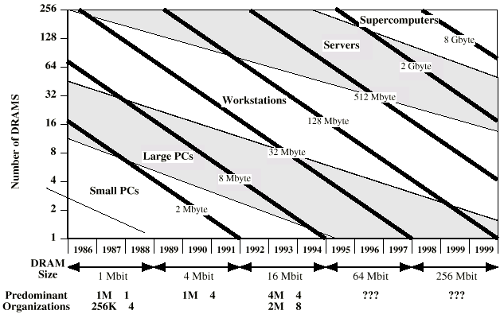
Trends in DRAM use (page 40)

Slide 28
Solutions
解决方案
Increase number of bits retrieved at one time
  Make DRAM “wider” rather than “deeper”
Change DRAM interface
  Cache
Reduce frequency of memory access
  More complex cache and cache on chip
Increase interconnection bandwidth
  High speed buses
  Hierarchy of buses
(Find & bring)

Slide 29
Pentium Evolution (1)
8080
  first general purpose microprocessor
  8 bit data path
  Used in first personal computer – Altair
8086
  much more powerful
  16 bit
  instruction cache, prefetch few instructions
  8088 (8 bit external bus) used in first IBM PC
80286
  16 Mbyte memory addressable
  up from 1Mb
80386
  32 bit
  Support for multitasking

Slide 30
Pentium Evolution (2)
80486
  sophisticated powerful cache and instruction pipelining
  built in maths co-processor
Pentium
  Superscalar
  Multiple instructions executed in parallel
Pentium Pro
  Increased superscalar organization
  Aggressive register renaming
  branch prediction
  data flow analysis
  speculative execution
精密强大的CACHE和指令流水线+内建数学协处理器
超标量+多指令并行执行
更多的超标量组织+寄存器重命名+转移预测+数据流分析+推测执行

Slide 31
Pentium Evolution (3)
Pentium II
  MMX technology
  graphics, video & audio processing
Pentium III
  Additional floating point instructions for 3D graphics
Pentium 4
  Note Arabic rather than Roman numerals
  Further floating point and multimedia enhancements
Itanium
  64 bit
  see chapter 15
See Intel web pages for detailed information on processors
MMX技术+图像、视频、音频处理
为3D图像增加的浮点指令
浮点、多媒体功能进一步增强
64位架构的CPU

Slide 32
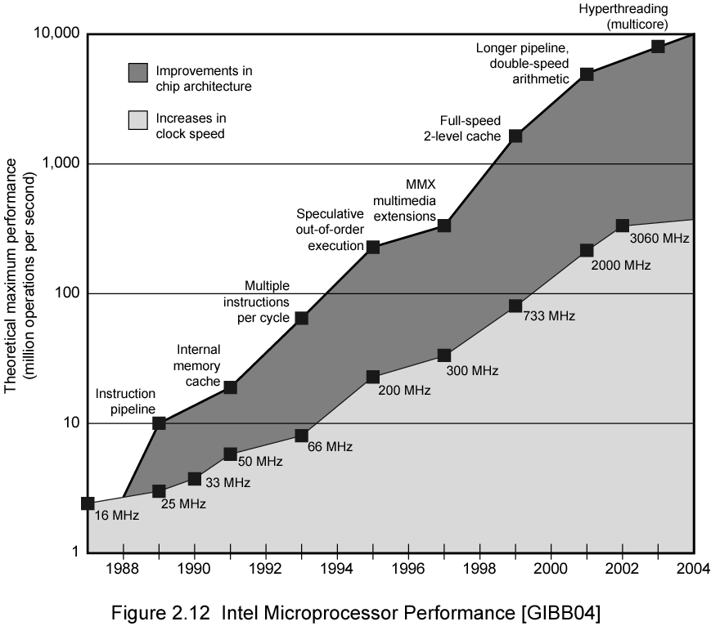
Intel Microprocessor Performance

Slide 33
Internet Resources
http://www.intel.com/
  Search for the Intel Museum
http://www.ibm.com
http://www.dec.com
Charles Babbage Institute
PowerPC
Intel Developer Home

Slide 34


Thank you for
your listening !

